Slide 1

INTRODUCTION TO STATISTICAL DATA ANALYSIS USING R & RSTUDIO
LUMUMBA WANDERA VICTOR
(M.Sc. Applied Statistics)
19th February, 2025
.

Slide 2
Session 2: HYPOTHESIS TESTING
Hypothesis Testing – Key Concepts
1️⃣ What is Hypothesis Testing?
Hypothesis testing is a statistical method used to make inferences about a population based on a sample.
It helps determine if a claim about a population parameter (mean, proportion, variance, etc.) is supported by evidence from the data.
2/8/2025
CENTER FOR DATA ANALYTICS AND MODELING, CHUKA UNIVERSITY
2

Slide 3
Session 2: HYPOTHESIS TESTING
2️⃣ Key Terminology
✔ Null Hypothesis (H0H_0H0​) → The default assumption that there is no effect, no difference, or no relationship in the population. Example: "The average height of students is 170 cm."
✔ Alternative Hypothesis (HAH_AHA​) → The claim we test against the null hypothesis. It suggests a difference, effect, or relationship exists. Example: "The average height of students is NOT 170 cm."
✔ Significance Level (α\alphaα) → The probability of rejecting H0H_0H0​ when it is actually true. Common choices: 0.05 (5%) or 0.01 (1%).
✔ p-value → The probability of obtaining the observed data (or more extreme) if H0H_0H0​ is true.
If p < α, reject H0H_0H0​ (significant result).
If p ≥ α, fail to reject H0H_0H0​ (not significant).
✔ Test Statistic → A value calculated from sample data to determine if the null hypothesis should be rejected. Examples: t-statistic, z-statistic, F-statistic, chi-square statistic.
✔ Type I Error (False Positive) → Rejecting H0H_0H0​ when it is actually true (false alarm). Controlled by setting a low α (e.g., 0.05).
✔ Type II Error (False Negative) → Failing to reject H0H_0H0​ when it is actually false (missed detection). Reduced by increasing sample size.
✔ Power of a Test → The probability of correctly rejecting H0H_0H0​ when it is false (1 - Type II Error). A higher sample size increases power.
2/8/2025
CENTER FOR DATA ANALYTICS AND MODELING, CHUKA UNIVERSITY
2

Slide 4
Session 2: HYPOTHESIS TESTING
3️⃣ Steps in Hypothesis Testing
1️⃣ State the Hypotheses: Define H0H_0H0​ and HAH_AHA​. 2️⃣ Choose Significance Level (α\alphaα) (e.g., 0.05). 3️⃣ Select the Test & Check Assumptions (e.g., t-test, chi-square test). 4️⃣ Compute the Test Statistic & p-value. 5️⃣ Interpret Results:
If p < α, reject H_0 (significant difference).
If p ≥ α, fail to reject H_0​ (no evidence for a difference).
2/8/2025
CENTER FOR DATA ANALYTICS AND MODELING, CHUKA UNIVERSITY
2

Slide 5
Session 2: HYPOTHESIS TESTING
4️⃣ Types of Hypothesis Tests
1. Parametric Tests (Assume Normality)
One-Sample t-test → Compare sample mean to a known population mean.
Two-Sample t-test → Compare means of two independent groups.
Paired t-test → Compare means before and after an intervention in the same group.
ANOVA → Compare means of more than two groups.
2/8/2025
CENTER FOR DATA ANALYTICS AND MODELING, CHUKA UNIVERSITY
2

Slide 6
Session 2: HYPOTHESIS TESTING
2. Non-Parametric Tests (No Normality Assumption)
Wilcoxon Signed-Rank Test → Alternative to one-sample t-test.
Mann-Whitney U Test → Alternative to two-sample t-test.
Kruskal-Wallis Test → Alternative to ANOVA.
3. Tests for Categorical Data
Chi-Square Test → Tests association between categorical variables.
Fisher’s Exact Test → Used for small sample sizes when chi-square is inappropriate.
4. Tests for Variances
F-Test → Compares variances of two groups.
Levene’s Test → Checks variance equality before using ANOVA.
2/8/2025
CENTER FOR DATA ANALYTICS AND MODELING, CHUKA UNIVERSITY
2

Slide 7
Session 2: HYPOTHESIS TESTING
5️⃣ One-Tailed vs. Two-Tailed Tests
✔ One-Tailed Test → Tests if the mean is greater than OR less than a value. Example: "Is the new drug better than the old one?" ✔ Two-Tailed Test → Tests if the mean is different (higher or lower). Example: "Is the new drug different from the old one?"
2/8/2025
CENTER FOR DATA ANALYTICS AND MODELING, CHUKA UNIVERSITY
2

Slide 8
Session 2: HYPOTHESIS TESTING: One Sample T-Test
One-Sample t-Test in R
Introduction
A one-sample t-test is used to compare the mean of a single sample to a known or hypothesized population mean. It tests the null hypothesis:
H0​:μ=μ_0
​where:
μ = Sample mean
μ_0​ = Population mean (hypothesized value)
The test assumes: ✅ The data are normally distributed. ✅ The sample is randomly selected. ✅ The population variance is unknown (otherwise, use a z-test).
2/8/2025
CENTER FOR DATA ANALYTICS AND MODELING, CHUKA UNIVERSITY
2

Slide 9
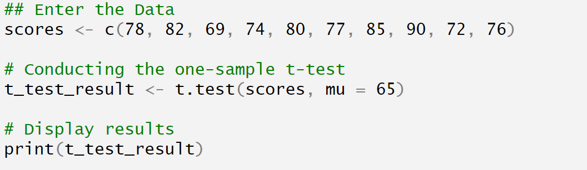
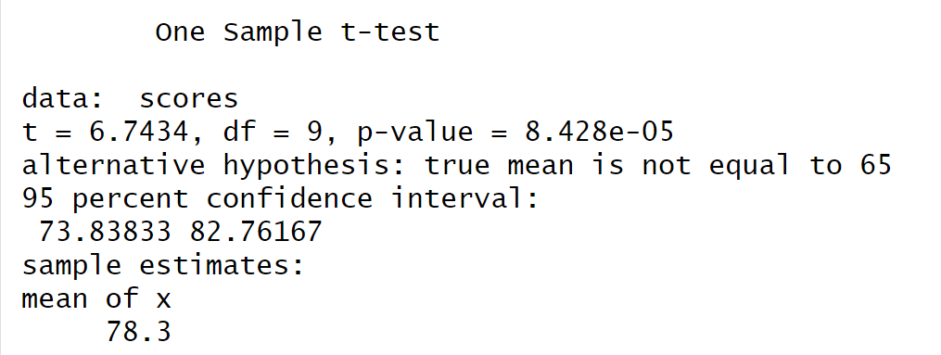
Session 2: HYPOTHESIS TESTING: One Sample T-Test
2/8/2025
CENTER FOR DATA ANALYTICS AND MODELING, CHUKA UNIVERSITY
2

Slide 10
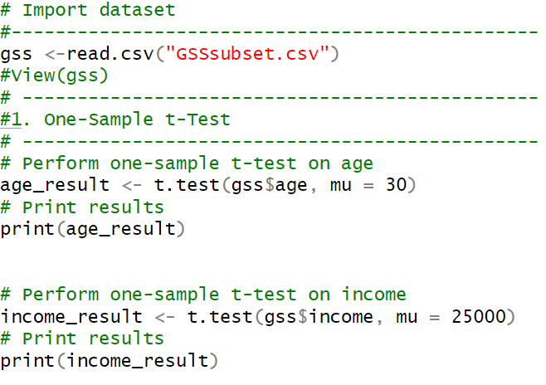
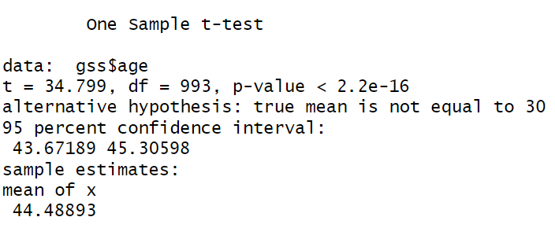
Session 2: HYPOTHESIS TESTING: One Sample T-Test using Real Data
2/8/2025
CENTER FOR DATA ANALYTICS AND MODELING, CHUKA UNIVERSITY
2

Slide 11
Session 2: HYPOTHESIS TESTING: Two – Sample T-Test
Two-Sample t-Test – Notes and R Code
1️⃣ What is a Two-Sample t-Test?
A two-sample t-test (independent t-test) is used to compare the means of two independent groups to determine if they are significantly different from each other.
2/8/2025
CENTER FOR DATA ANALYTICS AND MODELING, CHUKA UNIVERSITY
2

Slide 12
Session 2: HYPOTHESIS TESTING: Two – Sample T-Test
2️⃣ Assumptions of a Two-Sample t-Test
Before performing the test, ensure the following: ✔ Independence: The two groups are independent (not related). ✔ Normality: The data in each group follows a normal distribution (use shapiro.test() to check). ✔ Equal Variance (Optional): If variances are equal, use the standard t-test. Otherwise, use Welch’s t-test. The assumption of equal variance can be checked using Levene’s Test (leveneTest() in car package) or F-test (var.test()).
2/8/2025
CENTER FOR DATA ANALYTICS AND MODELING, CHUKA UNIVERSITY
2

Slide 13
Session 2: HYPOTHESIS TESTING: Two – Sample T-Test
3️⃣ Hypotheses for a Two-Sample t-Test
Null Hypothesis (H0H_0H0​): The two groups have equal means. H0:μ1=μ2​
Alternative Hypothesis (HAH_AHA​): The two groups have different means. HA:μ1≠μ2 (For a two-tailed test)
2/8/2025
CENTER FOR DATA ANALYTICS AND MODELING, CHUKA UNIVERSITY
2

Slide 14
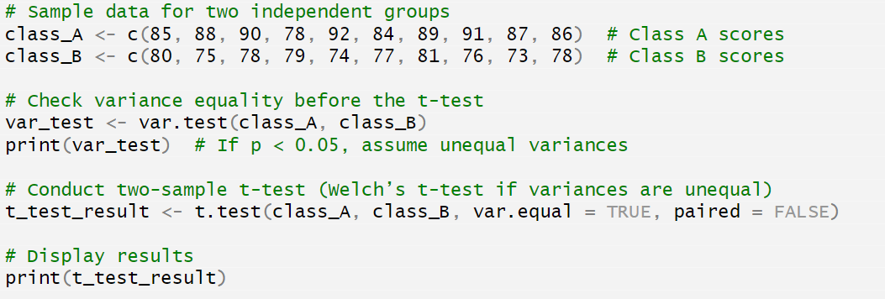
Session 2: HYPOTHESIS TESTING: Two – Sample T-Test
2/8/2025
CENTER FOR DATA ANALYTICS AND MODELING, CHUKA UNIVERSITY
2

Slide 15
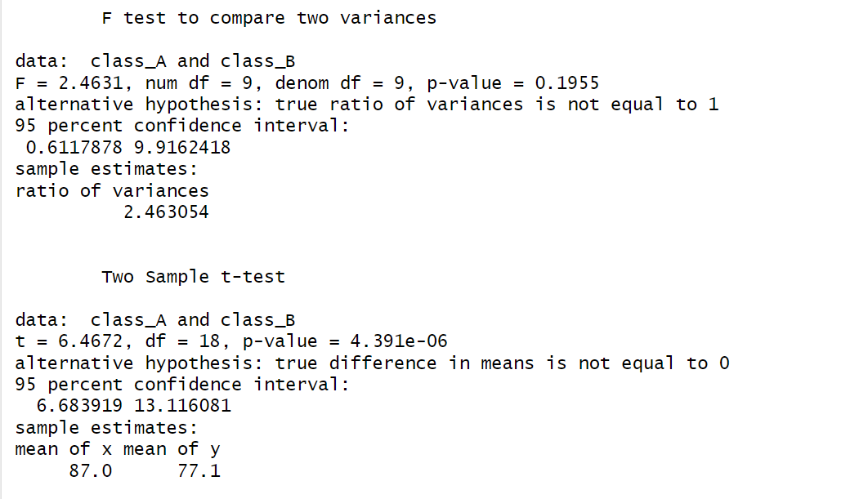
Session 2: HYPOTHESIS TESTING: Two – Sample T-Test
2/8/2025
CENTER FOR DATA ANALYTICS AND MODELING, CHUKA UNIVERSITY
2

Slide 16
Session 2: HYPOTHESIS TESTING: Two – Sample T-Test
Paired Sample t-Test – Notes and R Code
1️⃣ What is a Paired Sample t-Test?
A paired sample t-test (also called a dependent t-test) is used to compare two related (paired) measurements to determine whether there is a significant difference between them.
It is commonly used in before-and-after studies, pre-test/post-test comparisons, or when the same subjects are measured twice under different conditions.
2/8/2025
CENTER FOR DATA ANALYTICS AND MODELING, CHUKA UNIVERSITY
2

Slide 17
Session 2: HYPOTHESIS TESTING: Two – Sample T-Test
2️⃣ Assumptions of a Paired t-Test
✔ Dependent (paired) samples: Each observation in one group is directly related to an observation in the other group (e.g., same subject before and after treatment). ✔ Normality: The differences between paired observations should be approximately normally distributed (check using shapiro.test()).
3️⃣ Hypotheses for a Paired Sample t-Test
Null Hypothesis (H_0​): The mean difference between the two related samples is zero. H0:μd​=0
Alternative Hypothesis (HAH_AHA​): The mean difference is not zero. HA:μd≠0 (For a two-tailed test)
2/8/2025
CENTER FOR DATA ANALYTICS AND MODELING, CHUKA UNIVERSITY
2

Slide 18
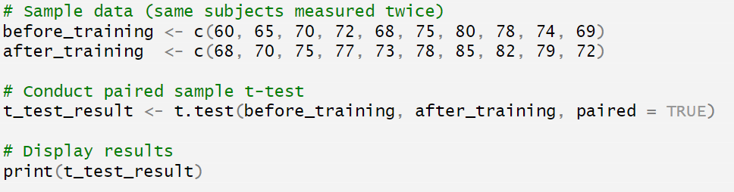
Session 2: HYPOTHESIS TESTING: Two – Sample T-Test
4️⃣ R Code for a Paired Sample t-Test
Example: Comparing Students' Test Scores Before and After a Training Program
We collected test scores before and after a training session and want to check if the training had a significant impact.
2/8/2025
CENTER FOR DATA ANALYTICS AND MODELING, CHUKA UNIVERSITY
2

Slide 19
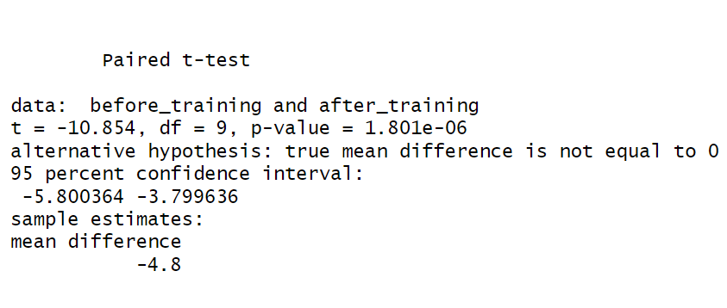
Session 2: HYPOTHESIS TESTING: Two – Sample T-Test
2/8/2025
CENTER FOR DATA ANALYTICS AND MODELING, CHUKA UNIVERSITY
2

Slide 20
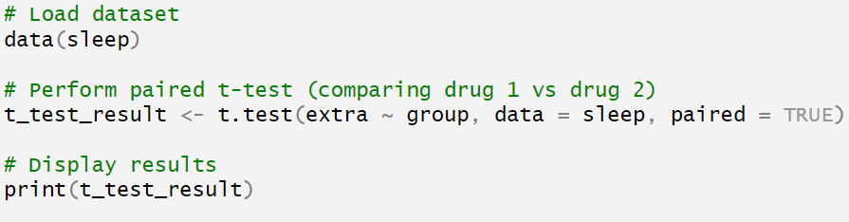
Session 2: HYPOTHESIS TESTING: Two – Sample T-Test
Sleep Data for Paired T-Test
🔹 Columns:
extra: The increase in sleep duration.
group: The drug administered (1 or 2).
ID: Subject ID (same subjects tested twice).
Since the same subjects received both drugs, we can use a paired t-test to check if there is a significant difference in sleep duration between the two drugs.
2/8/2025
CENTER FOR DATA ANALYTICS AND MODELING, CHUKA UNIVERSITY
2

Slide 21
Session 2: HYPOTHESIS TESTING: Two – Sample T-Test
Difference Between Welch’s Two-Sample t-Test and the Standard Two-Sample t-Test
The two-sample t-test and Welch’s t-test are both used to compare the means of two independent groups. However, they differ in their assumptions about variance.
2/8/2025
CENTER FOR DATA ANALYTICS AND MODELING, CHUKA UNIVERSITY
2

Slide 22
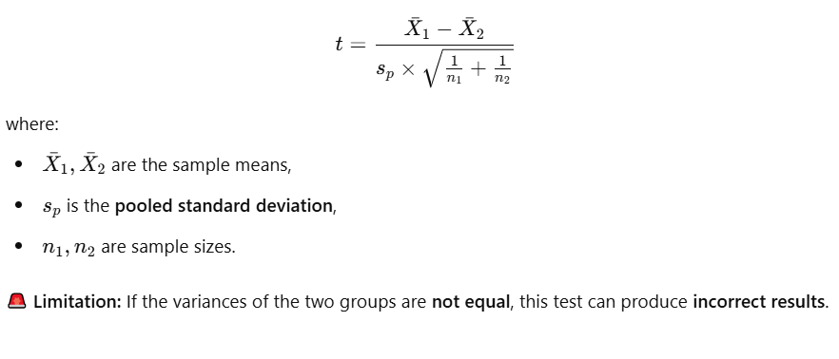
Session 2: HYPOTHESIS TESTING: Two – Sample T-Test
1️⃣ Standard Two-Sample t-Test (Student’s t-Test)
✅ Compares the means of two independent groups under the assumption that:
The variances of the two groups are equal (homogeneity of variance).
The data in both groups are normally distributed.
The two samples are independent.
📌 Formula:
2/8/2025
CENTER FOR DATA ANALYTICS AND MODELING, CHUKA UNIVERSITY
2

Slide 23
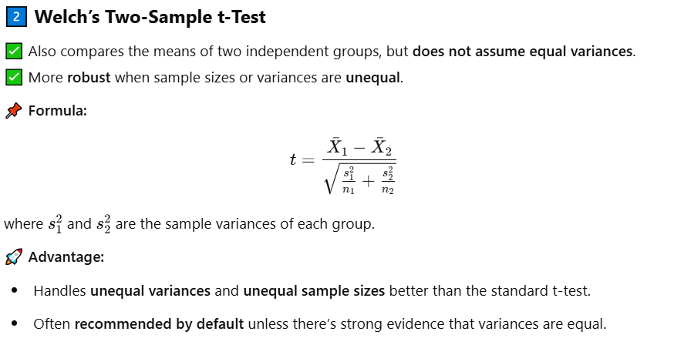
Session 2: HYPOTHESIS TESTING: Two – Sample T-Test
2/8/2025
CENTER FOR DATA ANALYTICS AND MODELING, CHUKA UNIVERSITY
2

Slide 24
Session 2: HYPOTHESIS TESTING: Two – Sample T-Test
3️⃣ Key Differences:
Feature | Standard Two-Sample t-Test | Welch’s t-Test
Assumption of Equal Variance | Yes | No
Robust to Unequal Variance | ❌ No | ✅ Yes
Works with Unequal Sample Sizes | ⚠️ Less accurate | ✅ Better
Formula Uses Pooled Variance? | ✅ Yes | ❌ No
2/8/2025
CENTER FOR DATA ANALYTICS AND MODELING, CHUKA UNIVERSITY
2

Slide 25
Session 2: HYPOTHESIS TESTING: Chi-Square Test
Chi-Square Tests and Fisher’s Exact Test – Notes & R Code
1️⃣ What is the Chi-Square Test?
The Chi-Square test is a statistical test used to determine whether there is a significant association between two categorical variables in a contingency table.
It compares observed frequencies with expected frequencies under the assumption that the variables are independent.
2/8/2025
CENTER FOR DATA ANALYTICS AND MODELING, CHUKA UNIVERSITY
2

Slide 26
Session 2: HYPOTHESIS TESTING: Chi-Square Test
2️⃣ Types of Chi-Square Tests
Chi-Square Test for Independence:
Determines whether two categorical variables are independent or associated.
Chi-Square Goodness-of-Fit Test:
Checks if a categorical variable follows a specific distribution.
3️⃣ Assumptions of the Chi-Square Test
✔ The data should be categorical (nominal or ordinal). ✔ Observations should be independent (each case belongs to only one category). ✔ Expected frequency in each cell should be ≥ 5 for valid results. ✔ The total sample size should be large enough.
2/8/2025
CENTER FOR DATA ANALYTICS AND MODELING, CHUKA UNIVERSITY
2

Slide 27
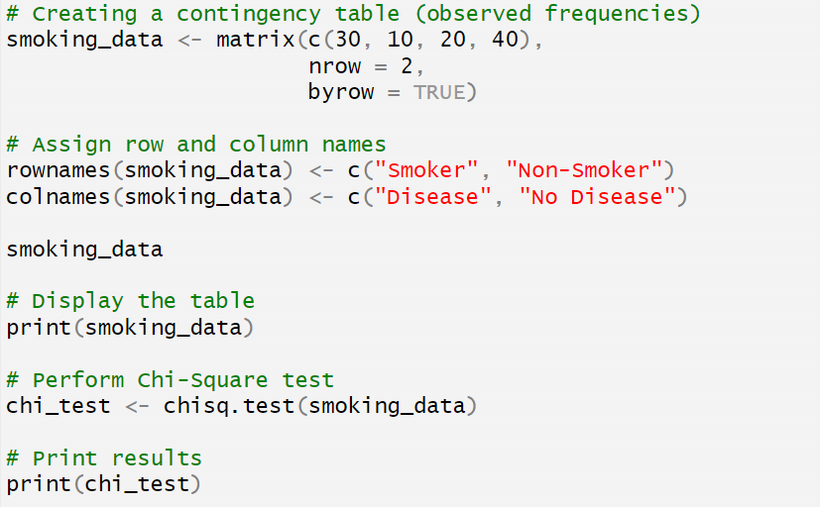
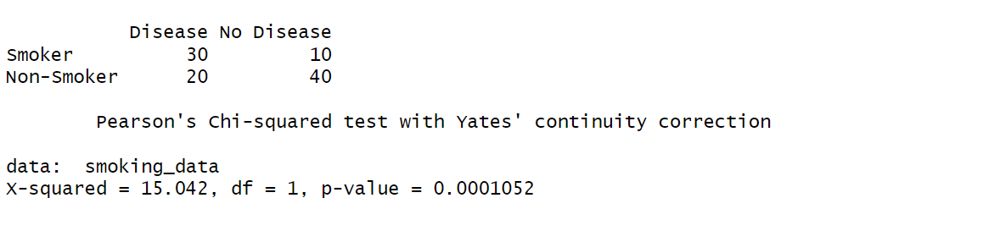
Session 2: HYPOTHESIS TESTING: Chi-Square Test
2/8/2025
CENTER FOR DATA ANALYTICS AND MODELING, CHUKA UNIVERSITY
2

Slide 28
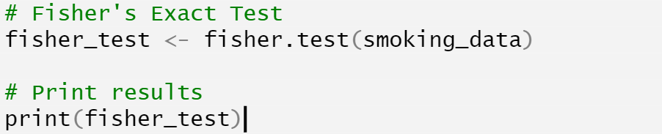
Session 2: HYPOTHESIS TESTING: Fishers Exact Test
2/8/2025
CENTER FOR DATA ANALYTICS AND MODELING, CHUKA UNIVERSITY
2

Slide 29

https://cdam.chuka.ac.ke
Thank you
2/8/2025
CENTER FOR DATA ANALYTICS AND MODELING, CHUKA UNIVERSITY

